Slide 1
Adversarial Vertex Mixup: Toward Better Adversarially Robust Generalization (AVmixup)
Saehyung Lee
Seoul National University, South Korea
CVPR 2020
2020-03-05

Slide 2
1
Overview
Contents
Problem
Experimental Results
Conclusion
Inspiration
Scheme
Future
Virtual vector
Adversarial example
Adversarial Vertex
Adversarial direction
Linear interpolation
Mixup
Keywords
Smooth labelling

Slide 3


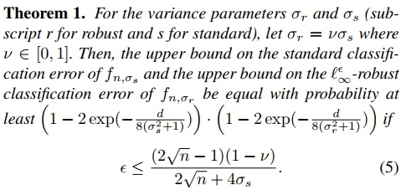

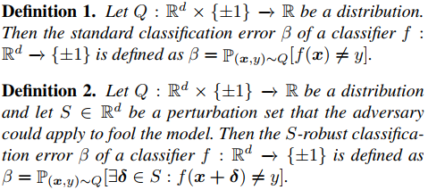
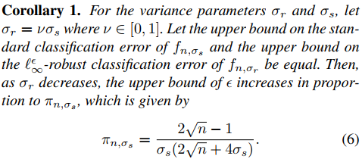
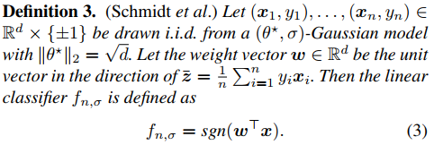
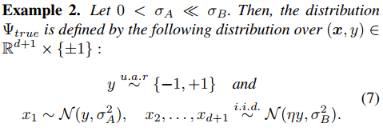
2
Theoretical Motivation

Slide 4
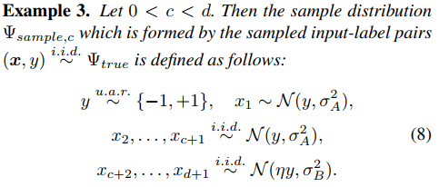

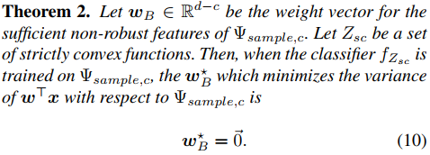
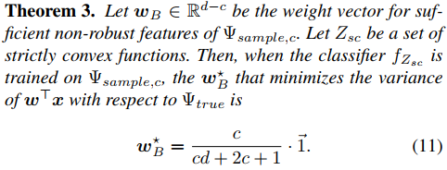
2
Theoretical Motivation

Slide 5

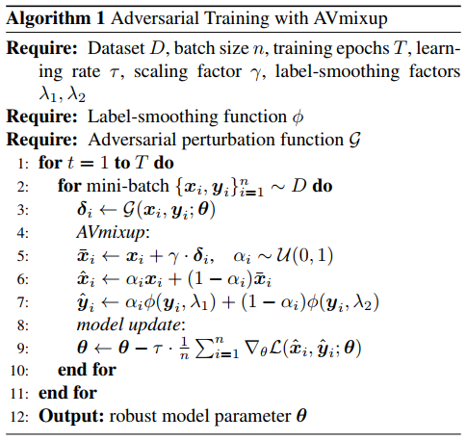
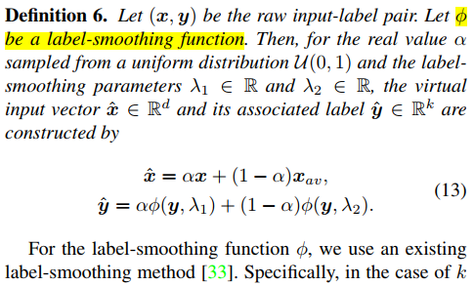
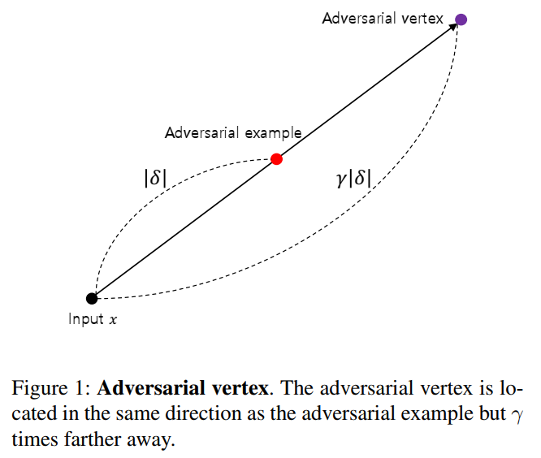
3
Proposed Method

Slide 6
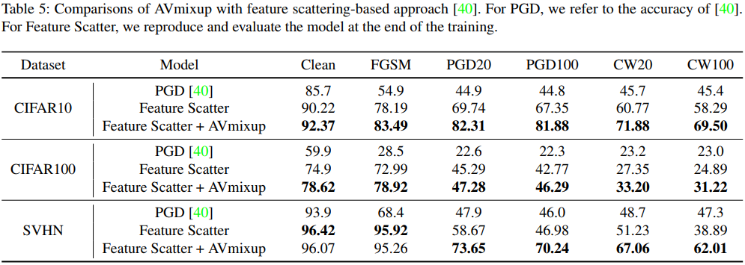
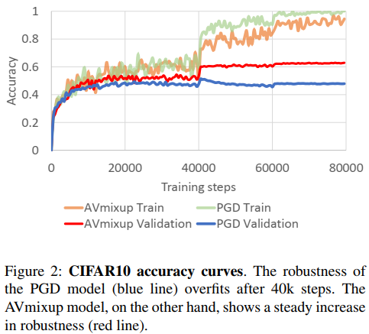
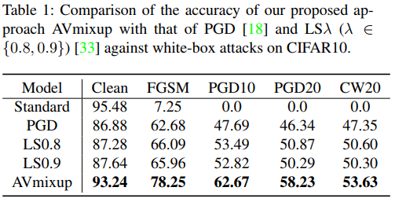
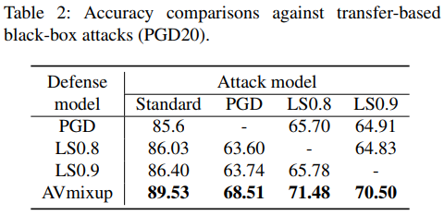
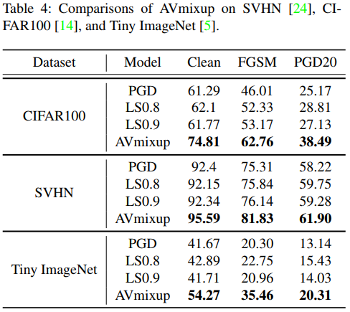
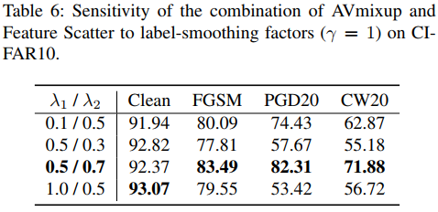
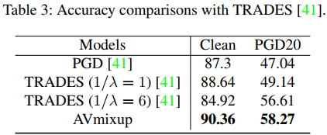
5
Experimental Results

Slide 7
6
Conclusion

Slide 8
7
Future

Slide 9
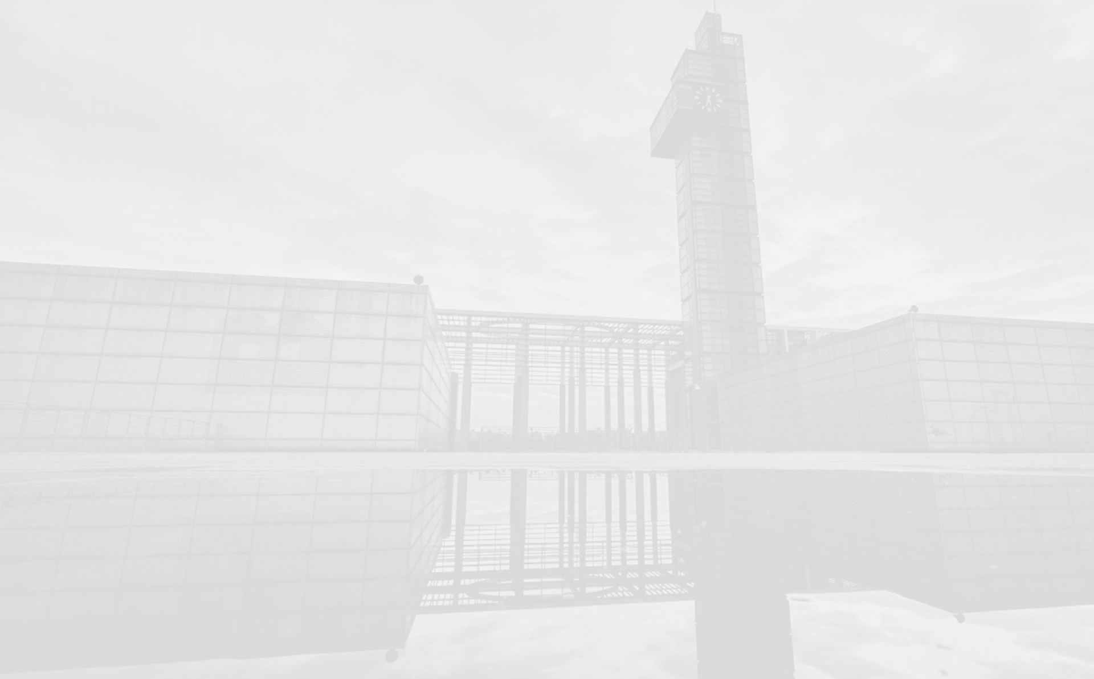


Thank you !
Mengdie Huang
Group AI Security
Lab Ruiyun
2020-10-7

